Slide 1

Prompt Engineering

Slide 2



Introduction to Prompt Engineering
Why It Matters
Core Concepts
Output Quality
No Retraining Required
Generative AI
Small changes in wording significantly impact output quality and accuracy.
Prompt engineering can improve how an existing model is used without changing or retraining its underlying parameters.
AI systems that generate new content such as text, code, images, audio, or video based on patterns learned from data.
Developer Productivity
Reduces iteration time and is a critical skill in modern software workflows.
Large Language Model (LLM)
A neural network trained on large amounts of text data to understand and generate language by predicting likely next tokens.
Prompt
A text instruction or query given to an AI model to guide its response.
Prompt Engineering
User Prompt
Send to LLM
LLM Processing
AI Output
The practice of crafting effective prompts to elicit desired outputs from AI models.

Slide 3

Anatomy of a Good Prompt
Key Components
Poor vs. Engineered Prompt
Role
Task
❌ Poor Prompt
"You are a senior code reviewer…"
Clearly state what you want the AI to do.
"Fix my code."
✅ Engineered Prompt
Context
Instructions
"You are a Python expert. Review this function for bugs and performance issues. Provide output as: [Issue], [Severity: High/Medium/Low], [Fix]. Only report actual errors, not style suggestions."
Provide relevant background and constraints.
Specify rules, format, length, or style.
Examples
Output Format
Structured prompts produce consistent, actionable, and higher-quality responses.
Show input-output pairs (few-shot prompting).
Specify structure: JSON, markdown, bullets, etc.

Slide 4
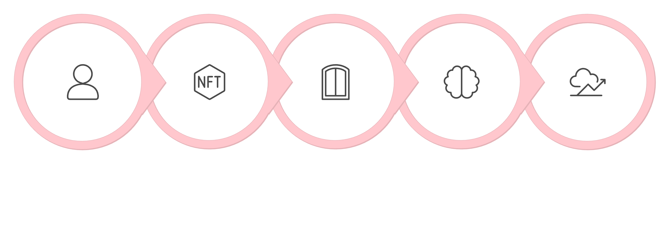






How Prompting Works & Major Techniques
Context Window
LLM Processing
Next-Token Prediction
User Input
Tokenization
Zero-shot
Few-shot
Ask the model directly without any examples — relies on pre-trained knowledge.
Provide one or more input-output examples to guide and calibrate model behavior.
Role Prompting
Task Decomposition
Assign a persona to the model — "You are a DevOps engineer with 10 years experience."
Break complex tasks into smaller, sequential steps for better accuracy.
RAG
Tool Calling / Agents
Retrieval-Augmented Generation — combine external knowledge retrieval with generation.
Enable models to call functions or APIs to extend their capabilities dynamically.

Slide 5



Prompt Engineering in Software Development
Practical Applications
Requirements & User Stories
Generate, refine, and validate requirements from natural language descriptions.
Code Generation & Refactoring
Produce boilerplate, optimize existing code, and suggest architectural improvements.
Testing
Auto-generate unit tests, integration tests, and edge-case scenarios.
Debugging & Code Review
Root cause analysis, quality assessment, and security vulnerability detection.
Documentation & Queries
Write API specs, SQL queries, schema designs, and technical documentation.
Critical Principle: AI assistance does NOT replace testing, code review, or human validation. All AI-generated outputs must be thoroughly reviewed before deployment.

Slide 6

Limitations, Security & Conclusion
Key Limitations & Risks
🧠 Hallucinations
Defensive Practices
Models generate plausible-sounding but factually false information.
🎲 Non-Determinism
Same prompt may produce different results across runs.
📏 Context Limits
Models have a maximum context capacity, and inputs that exceed it may be truncated, rejected, or otherwise handled differently depending on the system.
💉 Prompt Injection
Malicious or untrusted input attempts to manipulate the model into ignoring or conflicting with its intended instructions.
Prompt
LLM
Output
Validate
Software
🔐 Data Leakage
Sensitive data in prompts may be logged or exposed. Never include secrets or PII.
Prompt Engineering = Clear Instructions + Relevant Context + Constraints + Evaluation
🏴‍☠️ Jailbreaking
Adversarial prompts can bypass safety guidelines.
01
02
Validate All Outputs
Protect Sensitive Data
Always test and review AI-generated code before deployment.
Never include credentials, API keys, or PII in prompts.
03
04
Least Privilege
Treat External Input as Untrusted
Apply minimal permissions to any AI-connected system or agent.
Content retrieved externally may be adversarially crafted.

